Slide 1


HR – CV Filtering Use Case

Slide 2
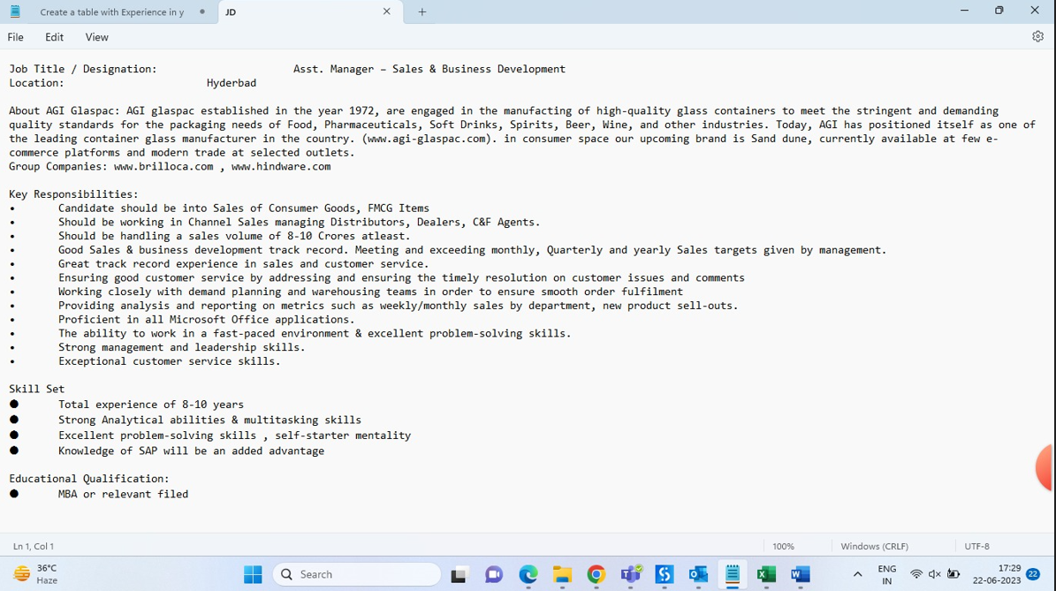
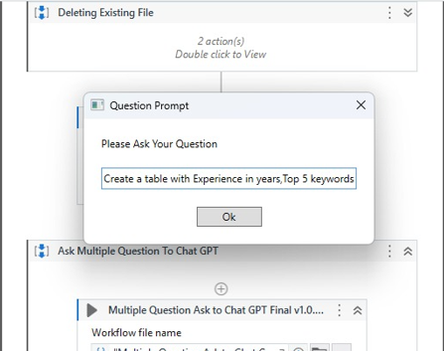
Reference given by HR team - AGI
Step : 1
Giving JD to Chat-GPT to get the experience required and Top 5 key word.
Extracting Experience & Top 5 Key word from JD

Slide 3
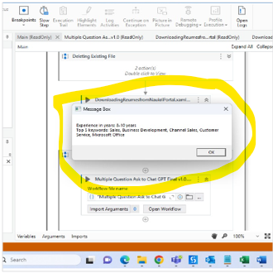
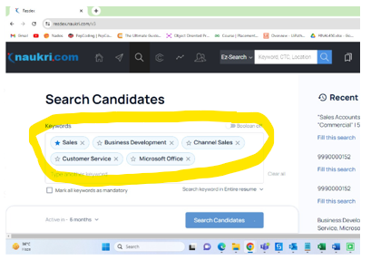
Step : 2
Result of Chat-GPT given to Naukri.com
Searching with key word & exp.level

Slide 4
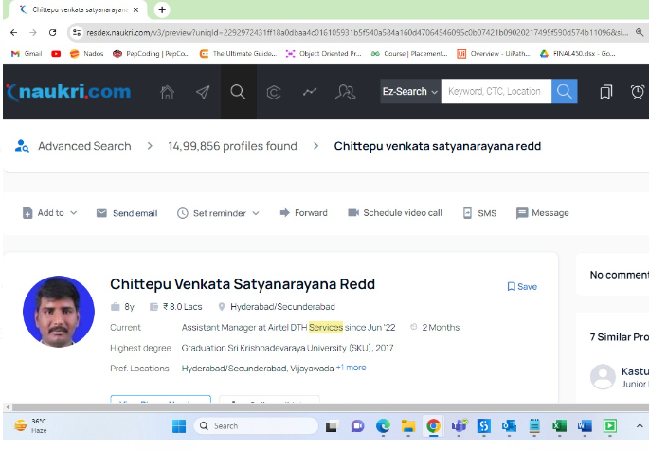
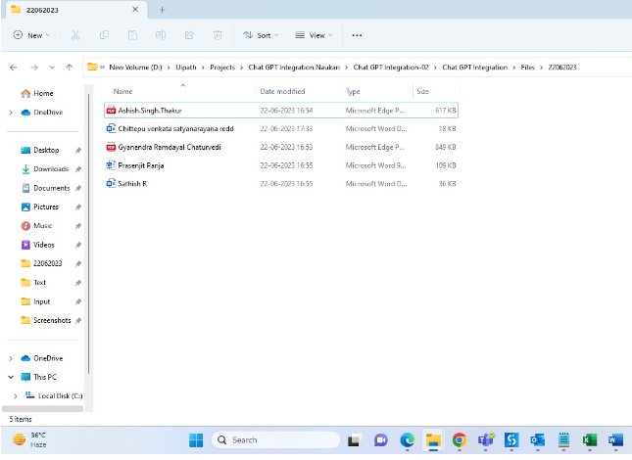
Step : 3
Downloading the CV to Local drive.
Downloading CV From Naukri.com
Save To Local File

Slide 5
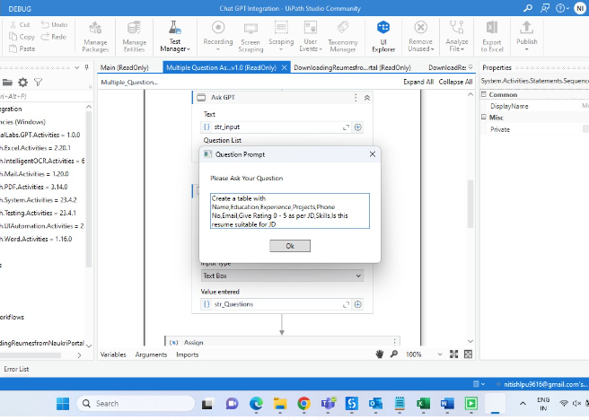
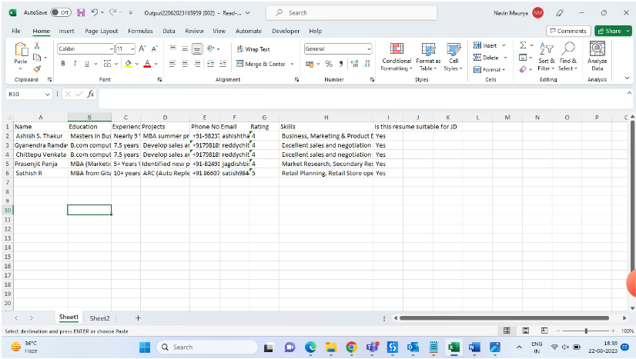
Step : 4
Giving Command to Chat-GPT and asking to give result.
Command :- Create a table with Name, Education, Experience, Projects, Phone No, Email, Give Rating 0 - 5 as per JD, Skills, Is this resume suitable for JD
Above command text Customizable...can add salary,location,region etc..
Input giving to the Chat-GPT
Final Output

Slide 6
Final Output

